Slide 1
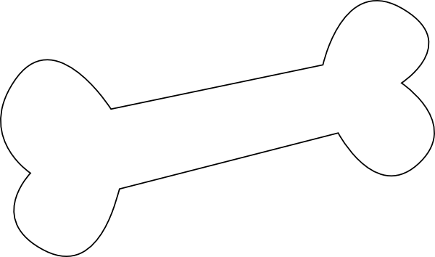
Dudley is a Good Boy
Written and Illustrated by: Leah Patinski

Slide 2
Dear grown ups,
Self-monitoring can be a fun way to help children pay attention to their OWN behaviors. Have your child color the pages as you read the story for a fun activity! For further information on self-monitoring, please see the annotated bibliography on the website!
Enjoy,
Leah

Slide 3
O
Hey there friend! My name is Dudley and I live with my mom and dad!

Slide 4
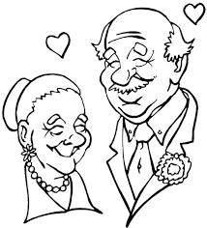
I love my mom and dad so much!

Slide 5
O
O
O
So I try to make good choices. But sometimes its hard to be a good boy. Especially when I’m hungry for snacks.

Slide 6
O
Sometimes, I smell something so good, I like to help my mom and dad eat it. But they don’t like that very much.

Slide 7
PARK
So my Mom and dad made me a special chart, to help me make good choices. Mom sets my special timer, and when I hear the DING, if I have not eaten their food, I get a pawprint on my super cool paw chart AND A BONE! When I fill it all the way up, I get to go to the P-A-R-K! (that spells park!)!!!

Slide 8
I have not visited the park in FUREVER. But today I decided that THIS, THIS was MY day! I’m going to go to that park!!! I earned one pawprint already, because I DID NOT eat moms breakfast… I can do this, I can do this.

Slide 9
Uh oh. I just woke up from a loonngg nap…

Slide 10
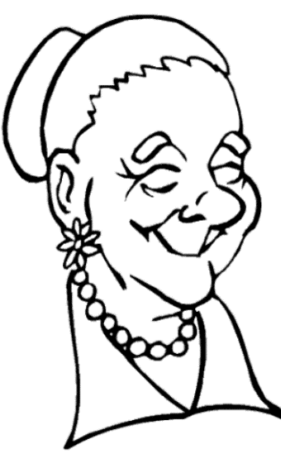
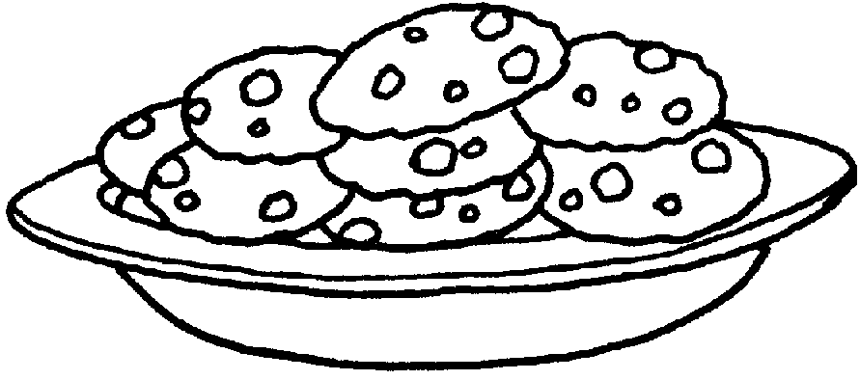
… and mom was making COOKIES!

Slide 11
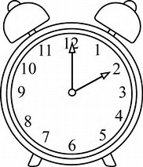
I walked over to mom, she set the special timer, and gave me a bone!

Slide 12
? ? ?
Will it be a good choice if I eat mom’s cookies?

Slide 13
PARK
I did NOT eat mom’s cookies. I made a great choice!!

Slide 14
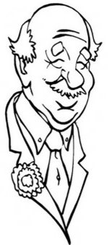
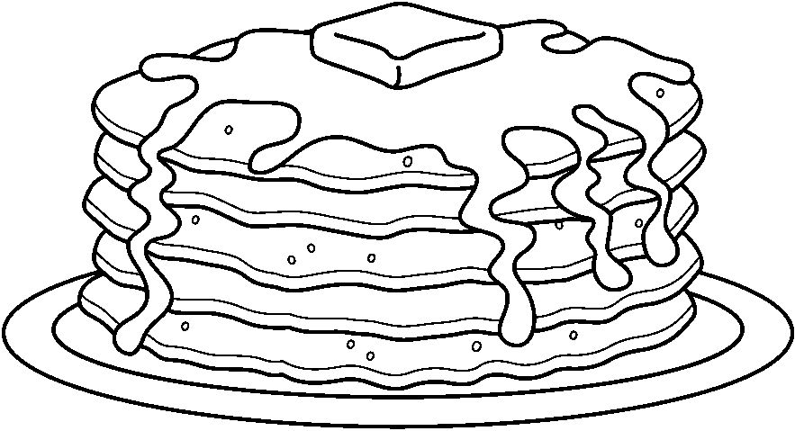
Uh-oh… Dad made pancakes… I’m REALLY hungry.

Slide 15
Mom hears my tummy rumble, sets the special timer, gives me a big hug, and a bone.

Slide 16
? ? ?
If I eat Dad’s pancakes, will I make a good choice?

Slide 17
PARK
I did NOT eat Dad’s pancakes!! I DID IT, I DID IT!

Slide 18
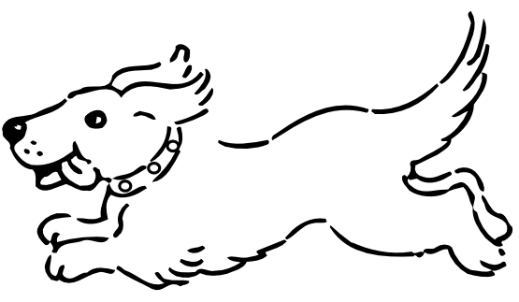
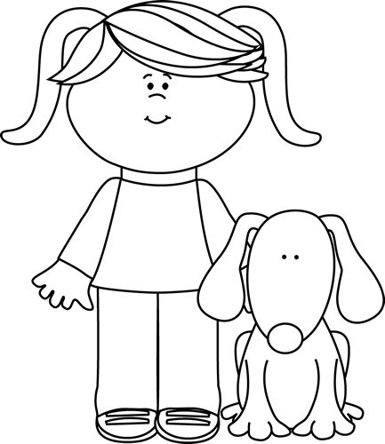
I love the park!!!

