Slide 1
Token Economy for Preschoolers
Gayle Antonacci
University of Pittsburgh
Notes:
This presentation will help you understand the benefits of a token economy system for preschool aged children. If you are struggling with your child’s behaviors this may be the intervention that will help. To continue through this slide show, simply click on the slide with your cursor or press the “enter” key.

Slide 2
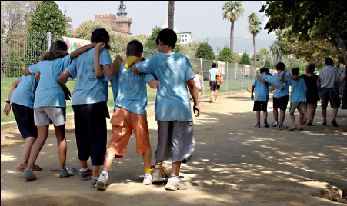
Outline
Glossary of key terms
An overview of behavior intervention
What is a token economy?
How does it work?
Used best in certain places and situations
A case study
Important reminders
Closing
Notes:
In this slide show I will discuss what a token economy is, research supporting the effectiveness of a token economy, when one might implement a token economy, and address the key points in making a token economy successful. I have included a glossary page to follow, as well as frequently asked questions that parents and teachers may have when thinking about using a token economy for their preschooler.

Slide 3
Glossary
Back-up Reinforcer: A specific object or event received in exchange for a disclosed amount of tokens
Desired Behavior: Any behavior that is wanted
Positive Behavior Support: Strategies involving procedures for teaching, supporting, and strengthening desired behaviors and not punishment for undesired behaviors
Response Cost: Taking away reinforcers when unwanted behaviors occur.
Notes:
To help you better understand token economies, here is a glossary of related terms.

Slide 4
Glossary Cont’d
Response Cost: Taking away reinforcers when undesirable behaviors occur
Token Economy: A behavior management system that uses token reinforcers as rewards for desired behavior that can be later exchanged for back-up reinforcers
Token Reinforcer: An object given when desired behaviors happen
Undesired Behavior: Any behavior that is unwanted
Notes:
Here are some more related terms you will hear throughout this slide show.

Slide 5
PBS and Token Economies
Positive Behavior Support is also known as PBS.
A token economy is a PBS
Teach
Strengthen
Support
Notes:
A token economy is a behavior changing strategy known as positive behavior support, or simply PBS. These particular behavior changing strategies work towards achieving positive behaviors by teaching, strengthening, and supporting the desired behavior.

Slide 6
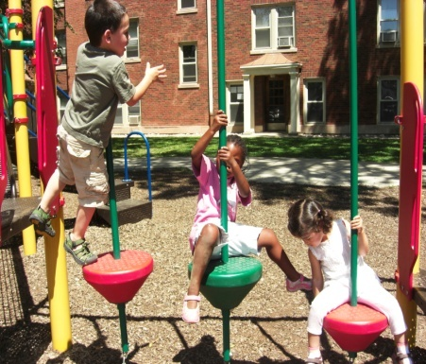
Positive Behavior Support
PBS strategies help to teach, strengthen, and support desired behaviors
Once implemented in schools, PBS is now commonly implemented in homes
Notes:
A token economy is considered a positive behavior support because of it’s ability to teach, strengthen, and support a desired behavior. While token economies were once only applied in schools, there are benefits to applying this strategy at home. The usefulness of behavior interventions, such as a token economy, in the home is supported by research. This research also shows the importance of collaboration between parents and school settings and how effectively a token economy in the home supports classroom goals.

Slide 7
What is a token economy?
Token Economy
Child earns token reinforcements for desired behaviors
Once enough token reinforcements have been earned, a back-up reinforcer is given
Response Cost
The child can lose tokens when undesired behaviors are shown
Notes:
So what exactly is a token economy? A token economy is a type of behavior management that uses a token reward system along with praise to help children know when they have made a good choice. By showing desired behaviors, the child receives tokens. Once enough tokens have been earned, that child can trade those in for a bigger or more special item. This item is known as a back-up reinforcer. Along with earning tokens, a response cost can be added to the token economy. If a response cost is utilized, the child has the ability to not only gain tokens for positive behavior, but lose tokens for undesired behavior. This places more emphasis on the importance of gaining tokens through desired behaviors. For example, if a child makes their bed, the desired behavior, that child will receive one sticker. If the child refuses to make their bed the next day, then they can lose the one sticker they gained the day before.

Slide 8
What is a token economy?
Level System
Used when child shows more desirable behaviors
Eventually leads to self monitoring behavior and more independence
Notes:
Ultimately, the goal for the child is to be able to make positive choices without tokens and praise. This is made possible with a level system. As the child works their way through the token economy they are also working their way through different levels of reinforcement. When the child shows more desirable behaviors, less token reinforcements are needed while still strengthening the desired behavior. Eventually, the child will be able to monitor their own behaviors and gain more independence from the token economy. If you’re an adult, think of the level system in terms of a job promotion. Once you get promoted, you are paid more, have more responsibilities, and require less supervision.

Slide 9
What is a token economy?
Individual token economy
Results prove effective in gaining control of undesirable behaviors
Each child earns their own tokens and reinforcements
Can be time consuming
Whole-Class token economy
Classroom works as a whole to receive rewards
Time and cost effective
Does not single out children with behavioral problems
Notes:
Token economies have two categories, individual or whole-class. For a parent at home, an individual token economy would work best. An individual token economy is personalized for one or two children at a time. Each child earns their own tokens based on their behaviors. The individual attention and time given to the child helps focus on the desired behavior. However, due to the rising number of children with behavioral problems, it seems more effective to put a whole-class token economy into place.
A whole-class system focuses on a few prominent undesired behaviors for an entire classroom. In a whole-class token economy the tokens are earned by the classroom’s overall behaviors and the reinforcement is given to the entire class after the required amount of tokens has been earned. A whole-class token economy is preferred in a classroom setting because it is more time and cost effective than an individual token economy. Also, a whole-class token economy eliminates the need to single out one specific child from the rest of the class, like an individual token economy may.

Slide 10
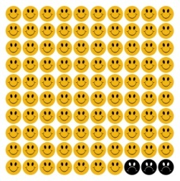
How does a token economy work?
Present the idea of a token economy in a way easily understood by the child
Clearly state the desired and undesired behavior
Ask for input from the child
What they would want for a token and a reward
Include a response cost if desired
Loss of tokens for undesirable behavior
Notes:
So far, this slide show has gone over the basics of what a token economy is, but why is this all necessary? For preschoolers, a token economy proves to be an easy and positive way to manage undesired behaviors. Before implementing a token economy for preschoolers in the classroom or at home, the rules of a token economy must be explained in terms easily understood by the child. Once the teacher or parent presents the idea of a token economy to the child, the child’s input can be used to tailor the token economy to their needs and interests. By having the child work towards a reward they pick for themselves, the child is more likely to pay attention and focus on the desired behaviors required of them. If the child is having difficulty with the desired behaviors, a response cost can be added to the token economy. A response cost is a penalty for undesired behavior. If a response cost is utilized, the child has the ability to not only gain tokens for positive behavior, but lose tokens for undesired behavior. This shows the child the importance of gaining tokens through desired behaviors

Slide 11
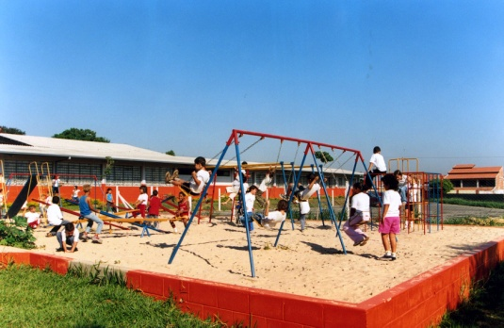
Best used in certain situations
Situations
Best suited for children who understand concept of token economy
Any situation where undesired and desired behaviors can be observed
Notes:
Maybe now you’re wondering if a token economy is even right for you and your child. While it may seem like a complicated process a token economy is very versatile and can be used in almost any situation and place.
For a parent, an individual token economy is better used in a home setting because at home, only one child can be focused on at a time if needed. For a teacher in a classroom setting, a whole-class token economy is more effective.
The situation best suited for a token economy is any situation where the child can understand what a token economy is and desired behaviors are observed. The child has to recognize the undesired behavior and understand what the desired behavior is. If your token economy is made to encourage the desired behavior of making a bed, you would be clear about this with your child. You would not identify the desired behavior as simply keeping their room clean, when you really would like their bed to be made.
Also, a token economy is best suited for a situation where the behavior can be observed. A desired behavior such as raising a hand before talking, is easily observed and monitored. In a home setting, desired behaviors like making a bed can also be easily observed.

Slide 12
Best used in certain places
Best place
Enough space post visual aides
Posters
Notes:
The place in which the token economy takes place should also have the space to post the rules and regulations of the token economy. For example, in a classroom, there should be a place where the child can always review the desired behaviors and undesired behaviors, what the token is and how to earn it, and also how many tokens must be earned to receive their reinforcement. Using a visual aide like a poster is a good way to post the rules in a classroom or home.

Slide 13
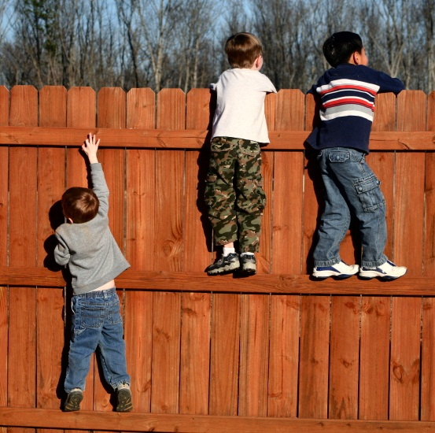
Token economy: A case study
Children ages 6, 8, and 10
Undesired behavior: Refusing to make bed and clean room
Desired behavior: Make bed
Notes:
A case study is a real life example of how token economy works. This case study involves a mother of three who is simply asking her children to make their beds at home.
Mrs. Smith is the mother of three children, ages six, eight, and ten. Mrs. Smith has had trouble getting all of her children to make their beds. Mrs. Smith had tried to give her children candy to make their beds but this does not work. Mrs. Smith is looking for a positive way to get her children to make their beds.

Slide 14
Case Study with Intervention
Implementation of token economy
Tokens along with praise
Introduction of token economy.
Explanation of token economy
Child involvement in choosing rewards (i.e. movie with mom)
Implementing a response cost
Notes:
Mrs. Smith has asked for the help of a behavior intervention specialist. After meeting with the Smith family, the specialist believes a token economy is best for them. The specialist hopes the children will be able to understand the concept of the token economy because of their ages and will be able to help in the planning of their own token economy. The specialist tells the family a token economy is a behavior management system where tokens are used as reinforcers and exchanged for a back-up reinforcer. The specialist tells Mrs. Smith to pick a reinforcer to be given to the children when the desired behavior is shown. Mrs. Smith chooses stickers for the children. The specialist then explains to Mrs. Smith that when a certain number of stickers is earned by each child they earn their back-up reinforcer. Because of the ages of Mrs. Smith’s children, a low number of stickers, in this case four, are chosen to be earned by each child. The specialist then explains to Mrs. Smith that each child will pick their back-up reinforcer in order to ensure it is one they will want to work for. All children pick their back-up reinforcement to be watching a movie with Mom. The specialist then tells Mrs. Smith when she presents the token economy to her children it is important to use terms they will understand. Mrs. Smith should also pick a place in her home to visually post the regulations of the token economy. Mrs. Smith should remind her children of the desired behaviors, what the tokens are, and how many tokens they must earn to get their back-up reinforcement.

Slide 15
Case Study with Intervention
Introduction of response cost
Desired behavior
Making bed and cleaning room
Notes:
Because Mrs. Smith clearly explained how a token economy will work for her children in her home and the consistent praise and token reinforcements, Mrs. Smith’s children are showing signs of improving their desired behaviors. However, Mrs. Smith does not feel the token economy is 100% effective. The specialist explains to Mrs. Smith she can add a response cost to the token economy. Now, if one child shows undesired behaviors, they lose a sticker. It seems as though Mrs. Smith’s children are seeing the importance of exhibiting the desired behaviors their mother requires of them and because of the praise and token reinforcements, their desired behaviors are becoming more consistent.

Slide 16
Important Reminders
Base token economy on specific developmental needs
When beginning a token economy
Use terms easily understood by child
Make sure the child is capable of participating in a token economy
Make the token economy FUN!
Use tokens that appeal to the child
Use rewards they pick for themselves
Notes:
Before including your child in a token economy, be sure to structure the token economy around specific developmental needs. Explain which behaviors are desired and make sure the child understands them as well. From the age of an older two-year old and above, the concept of tokens as symbols should be understood. Some children may not be capable of understanding the concepts of tokens, rewards, and response costs. In this case, a token economy would not be the best management tool to use. If the child is capable of understanding the concept of a token economy, be sure to use terms the child is familiar with to ensure a positive outcome without confusion. It is also important to make sure the token economy appeals to the child. Have brightly colored tokens or stickers. Incorporate some entertaining props such as puppets or posters. Using visual aids in the token economy helps to serve as reminders of the desired behaviors and more importantly, their goal.

Slide 17
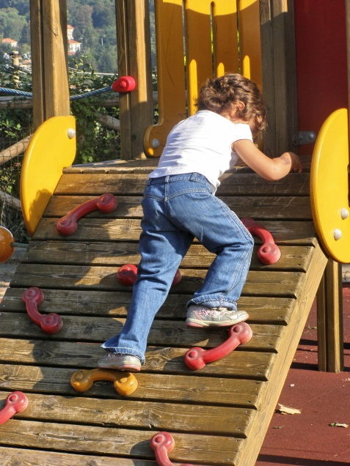
Important Reminders
BE CONSISTENT!!
Always give praise for desired behavior along with token
Give praise and token reinforcement immediately after desired behavior occurs
Notes:
While you think your child will repeat desired behaviors by simply bribing them with tokens, this is not the case. By including a positive comment with the handing out of the token; the token then has meaning to the child. It will also get your child use to enjoying positive comments given to them because not everyone will hand them a sticker for desired behaviors. Along with praising the child when giving a token, the timing of the praise is equally important. By immediately showing recognition for the child’s desired behaviors, the child learns what exact behaviors are getting them so much attention and rewards, therefore, causing them to continue performing the desired behaviors. Eventually, the child will maintain the behavior on their own.

Slide 18
Frequently Asked Questions
Q: Why is it important to pair praise with a token reinforcer?
A: It is important because unless the token reinforce is paired with something that has meaning to the child, then the token reinforce simply has no meaning to the child and the token economy will have no affect on their undesired behaviors
Q: Is it okay to use food as a token reinforcer?
A: No, food should never be used to reinforce a child for a few reasons. First, for a child to be hungry enough to accept a food reward means they must be denied that particular item. Also, food allergies can come into play and it may be difficult to find a food that all children will want to eat.
Notes:
You may still have some questions about token economies. Here are a few frequently asked questions about token economies.

Slide 19
Closing
Notes:
I hope this slide show was helpful to you and hopefully you will find it useful when a token economy is used in your home or school setting. Remember to praise your children for any improvements they may make during the token economy and never set them up to fail. Reward them for desired behaviors they are already showing and keep the intervention positive!

Slide 20
References
Filcheck, H. A., & McNeil, C. B. (2004). The use of token economies in preschool classrooms: Practical and philosophical concerns. Journal of Early and Intensive Behavior Intervention, 1(1), 94- 104.
Filcheck, H. A., McNeil, C. B., Greco, L. A., & Bernard, R. S. (2004). Using a whole-class token economy and coaching of teacher skills in a preschool classroom to manage disruptive behavior. Psychology in the Schools, 41(3), 351-361. Retrieved from http://search.ebscohost.com/login.aspx?direct=true&db=aph& AN=12215735&site=ehost-live
Jull, S. & Mirenda, P. (2011). Parents as play date facilitators for preschoolers with autism. Journal of Positive Behavior Interventions, 13(1), 17-30. doi:10.1177/1098300709358111
Kerr, M.M, & Nelson, C.M. (2010). Strategies for addressing behavior problems in the classroom (6th ed.). Upper Saddle River, NJ: Pearson Education Inc.

